Slide 1
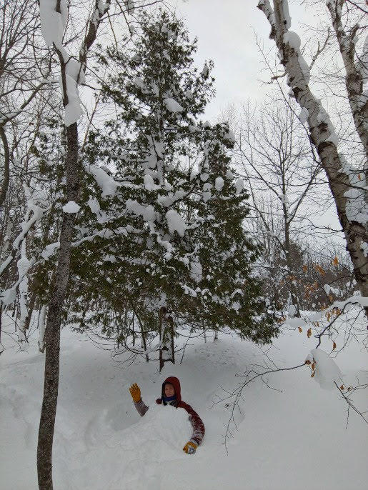
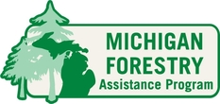
Winter Tree Identification
Joe Nash
District Forester
Clare and Gladwin Conservation Districts
(989) 539-6401 Ext. 3
joe.nash@macd.org

Slide 2
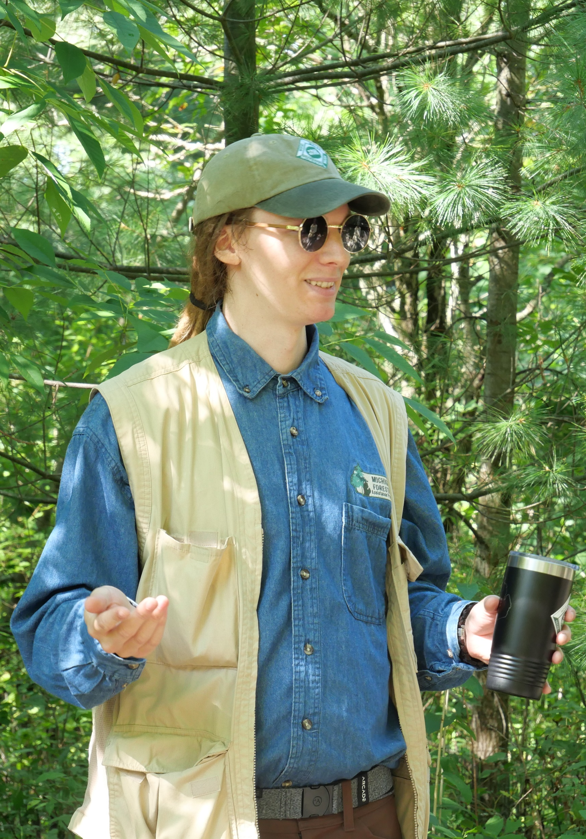
About me
Grew up in a St. Clair, MI
Graduated in May 2020 as the "Outstanding Senior in Forestry"
- Michigan Technological University in Houghton, MI
Graduated in May 2022 with M.S in Forest Resource Management
- SUNY ESF in Syracuse, NY
Diverse background in
forest soils and forest ecology
mycorrhizal fungi
forest inventories, especially downed wood
forest biomass calculations
data analysis
Started at Clare + Gladwin Conservation Districts in July 2022
Find me in the woods foraging, hiking, camping, snowshoeing, or just wndering around

Slide 3
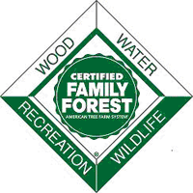
Forestry Assistance Program
Advocate for sustainable forest management on private lands
Outreach and technical assistance
Help family forest owners achieve their goals for woodland ownership
Management options
Referrals to consultants (private foresters, arborists, loggers)
Recommendations for relevant conservation practices
Tax incentive & conservation programs
Qualified Forest Program (QFP)
Commercial Forest Program (CFP)
Cost-share programs
Natural Resource Conservation Service (NRCS)
Michigan DNR Forest Stewardship Program (FSP)
Third-party certifications
American Tree Farm System (ATFS)
Michigan Agriculture Environmental Assurance Program (MAEAP)

Slide 4
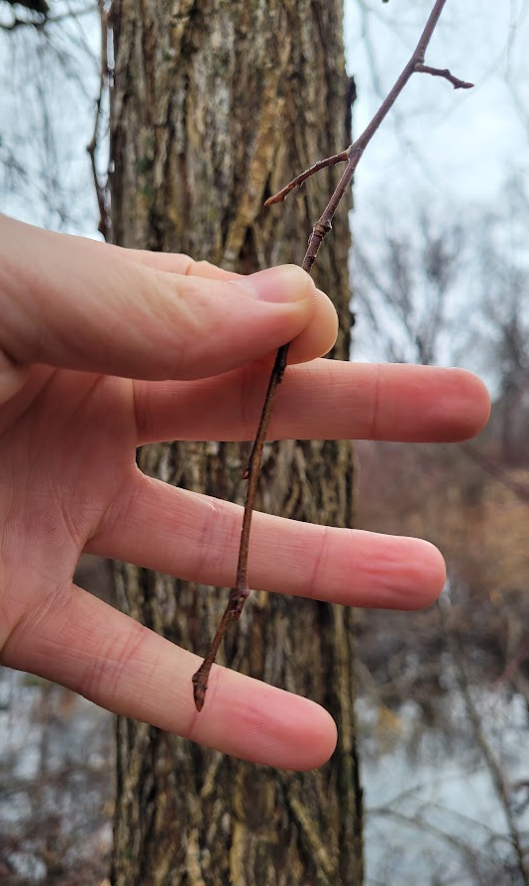
Notes on identification
Context clues are important!
Characteristics and life history of trees and how they relate to environmental influences
Use your senses!
Nature is not uniform!
Trees are variable in appearance (just like we are!)
More features in agreement = More confident ID
With a little help from my friends…
Fungi, moss, lichen, wildlife
Some species often or exclusively associate with others
Silvics

Slide 5
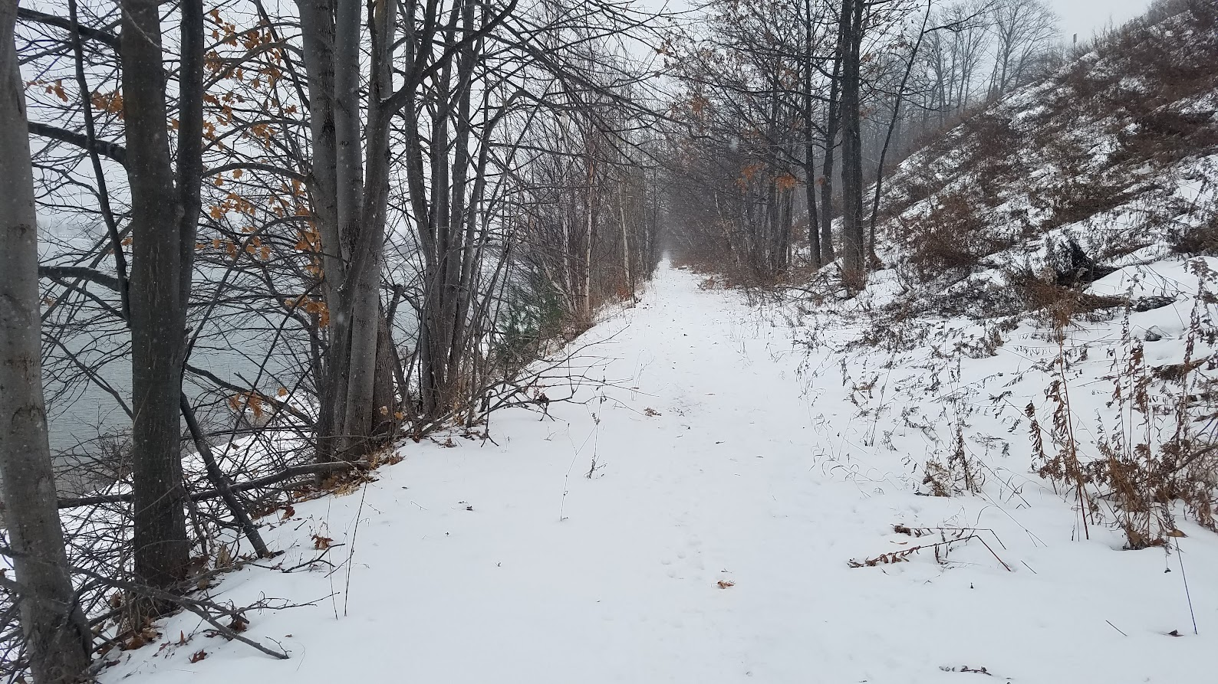
What to look for in winter
Marcescent trees – leaves wilt but remain attached to twig
Oak & beech
Bark
Branching pattern
Twigs
Buds
Seeds

Slide 6
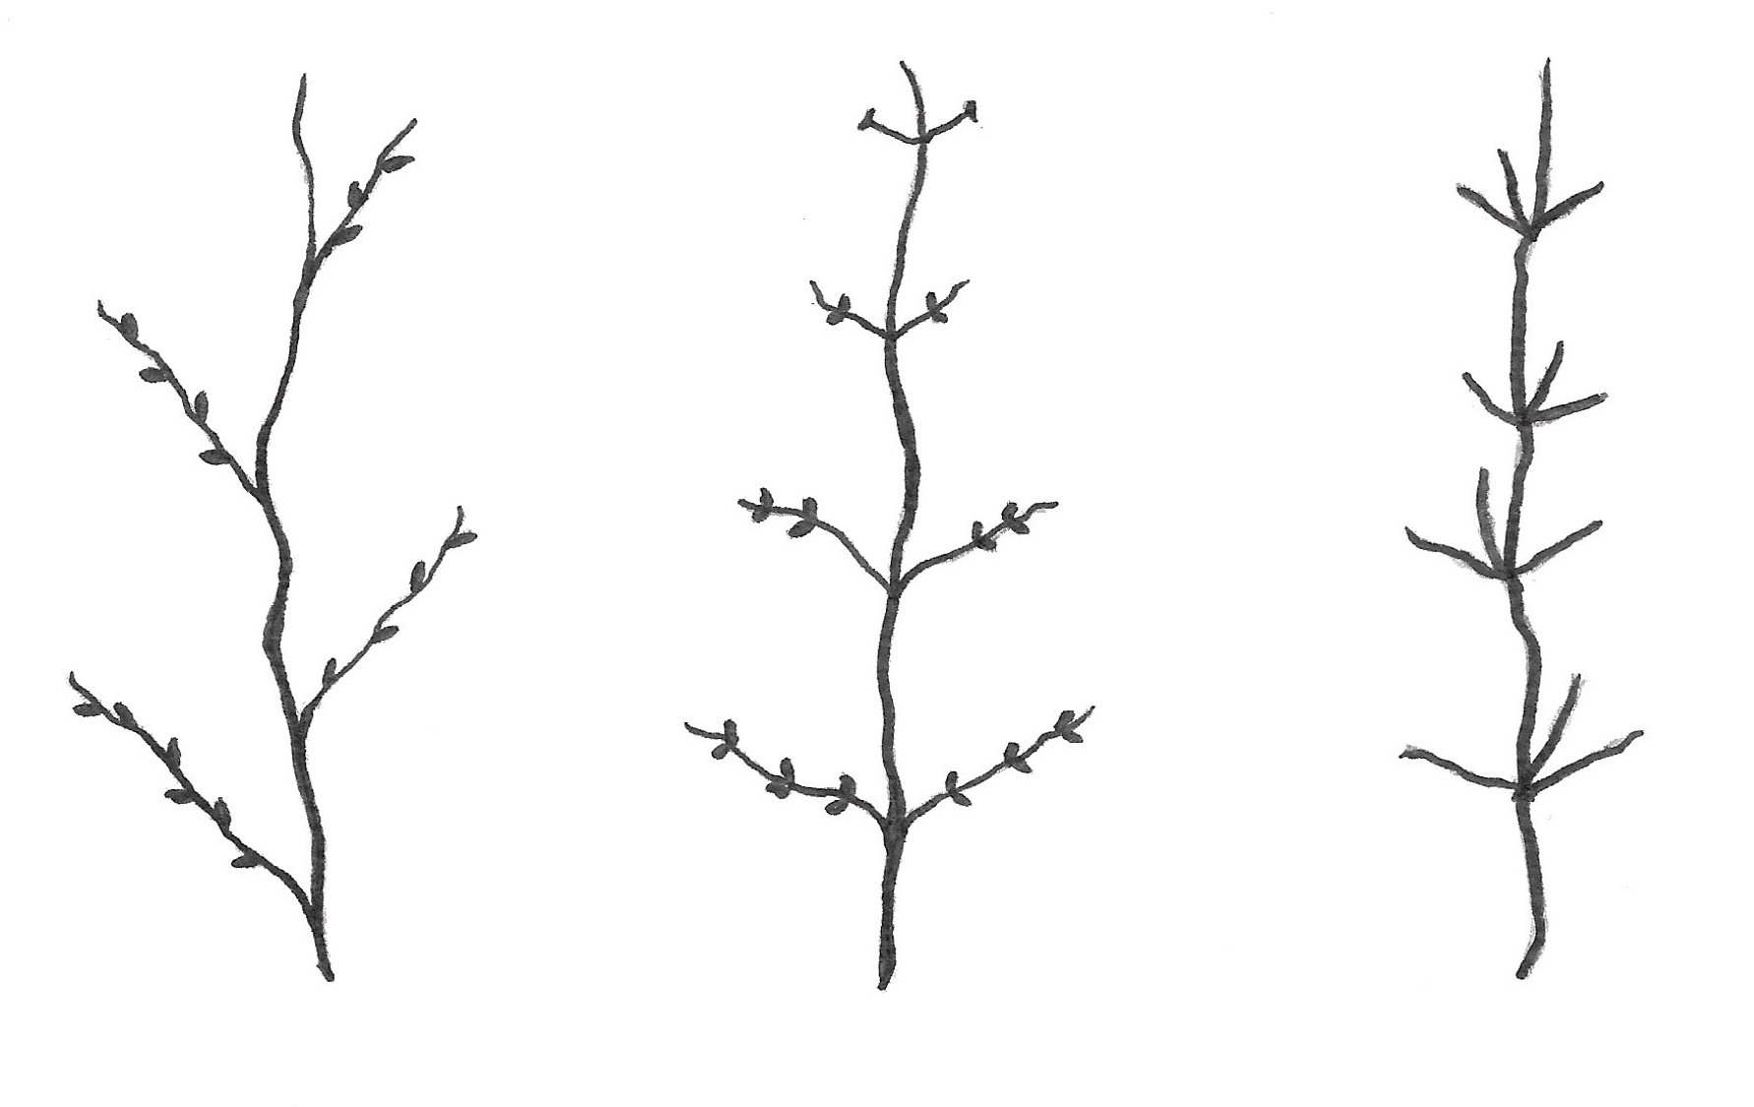
Branching pattern
Alternate
Opposite
Whirled

Slide 7
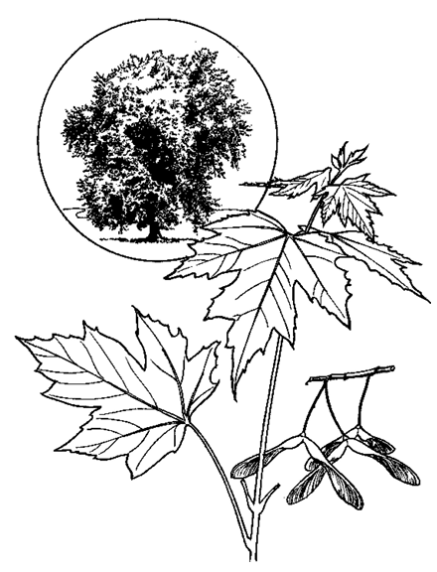
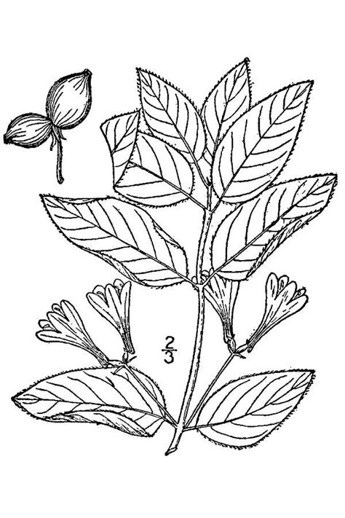
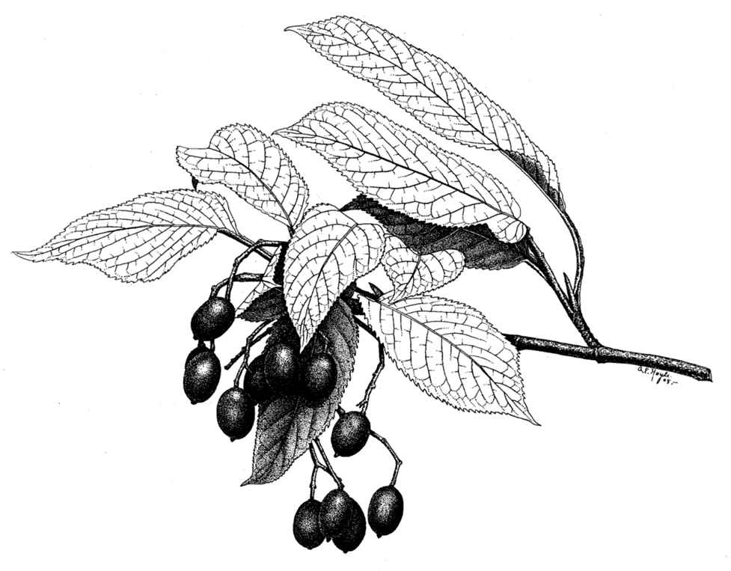
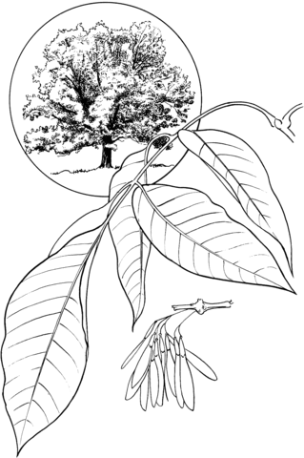
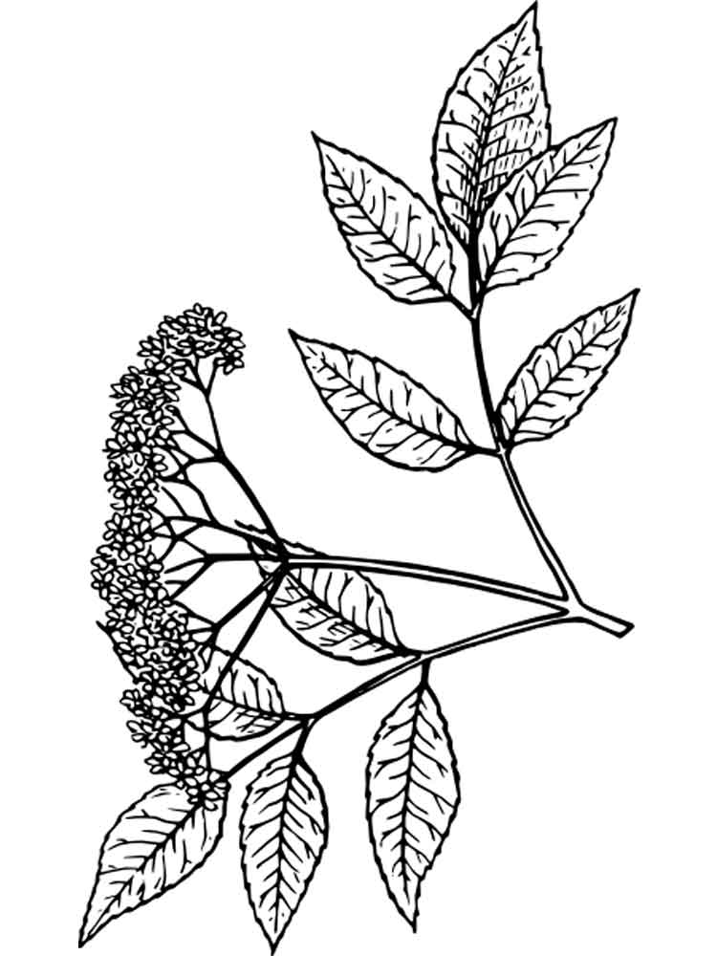
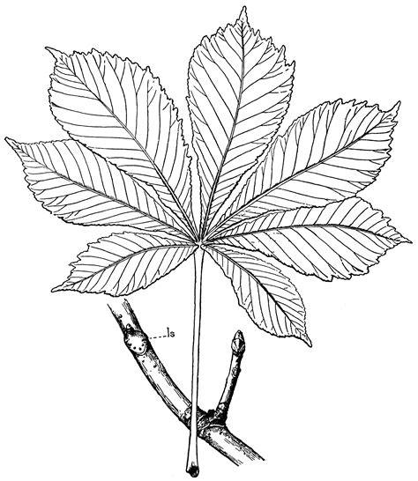
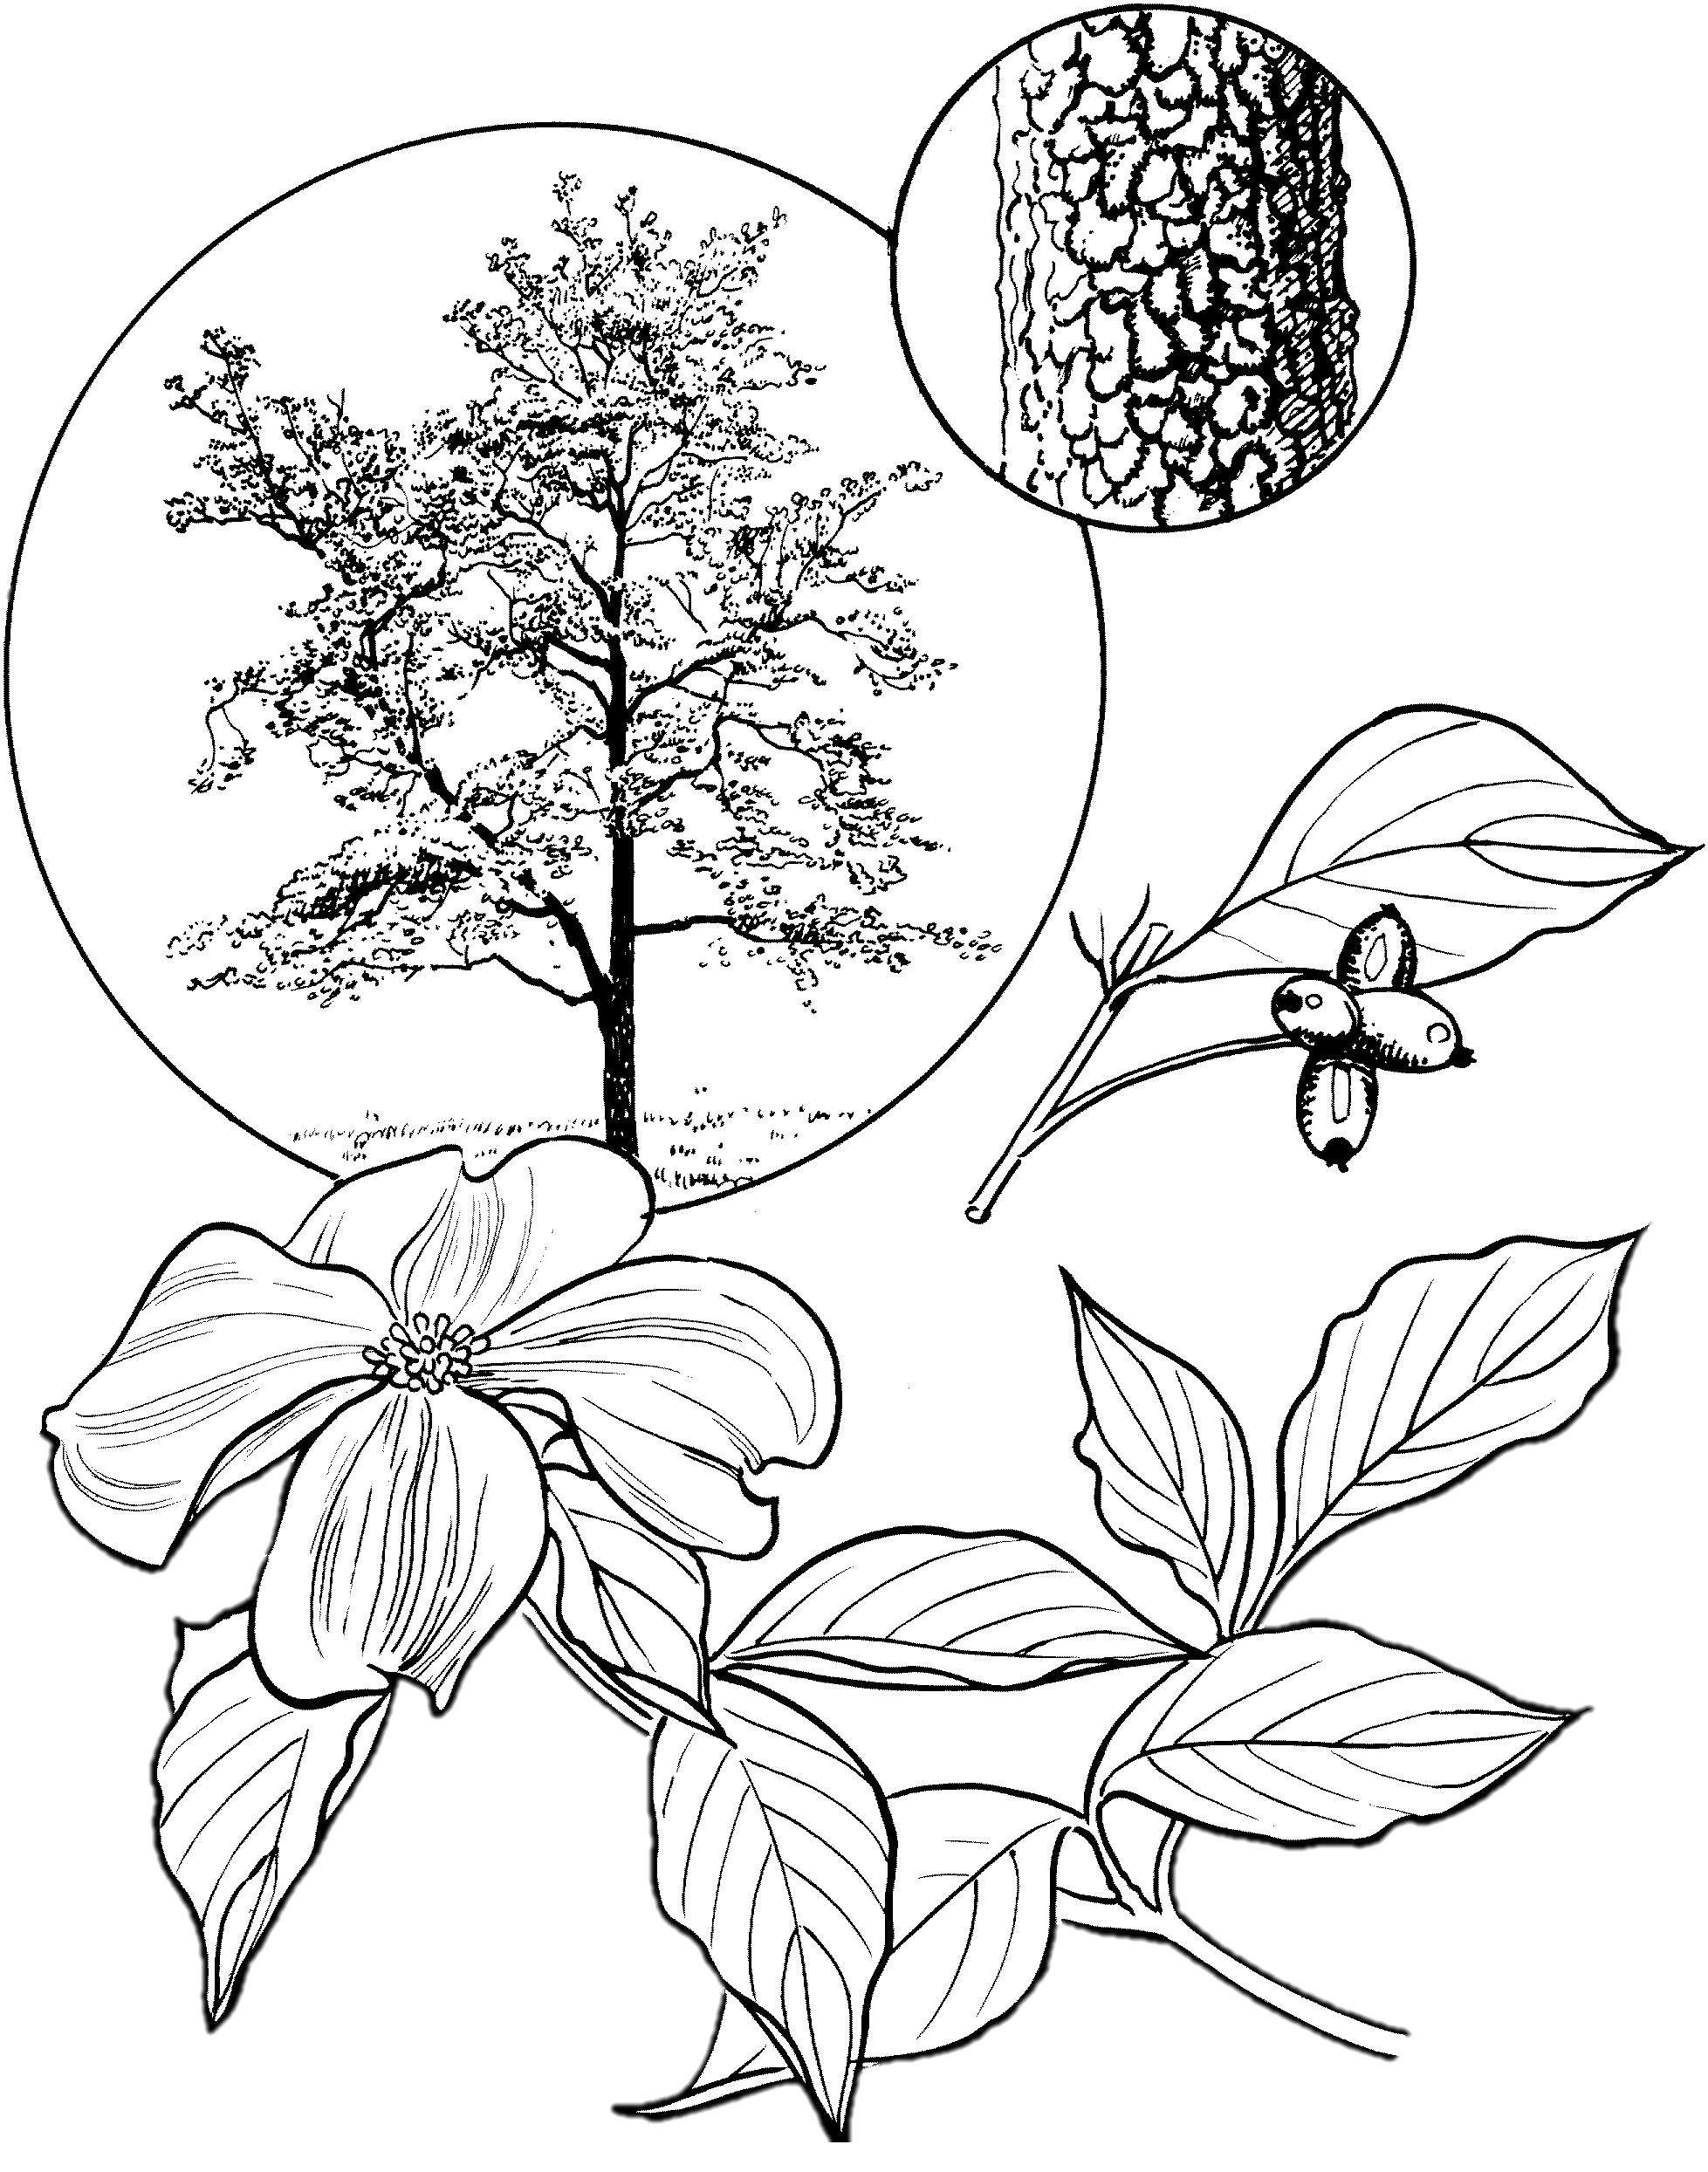
Opposite branching pattern
MADCapHorse
Maple
Caprifoliaceae
Honeysuckle
Viburnum (reclassified as Adoxaceae)
Elderberry (reclassified as Adoxaceae)
Ash
Horse-chestnut (non-native)
Dogwood

Slide 8
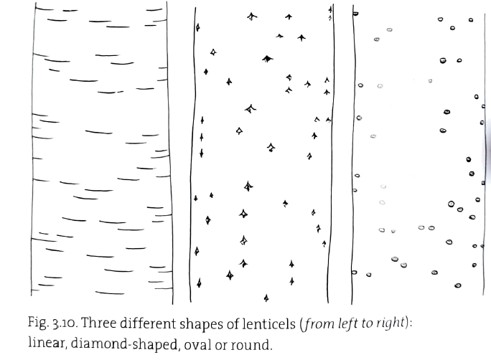
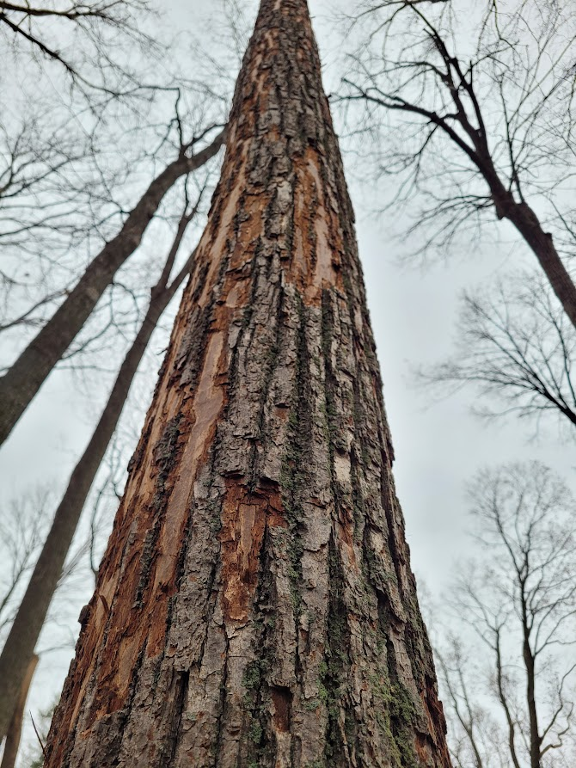
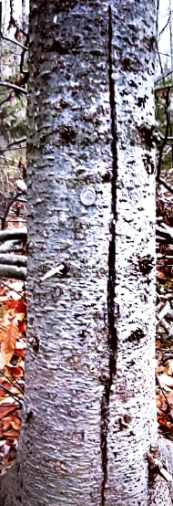
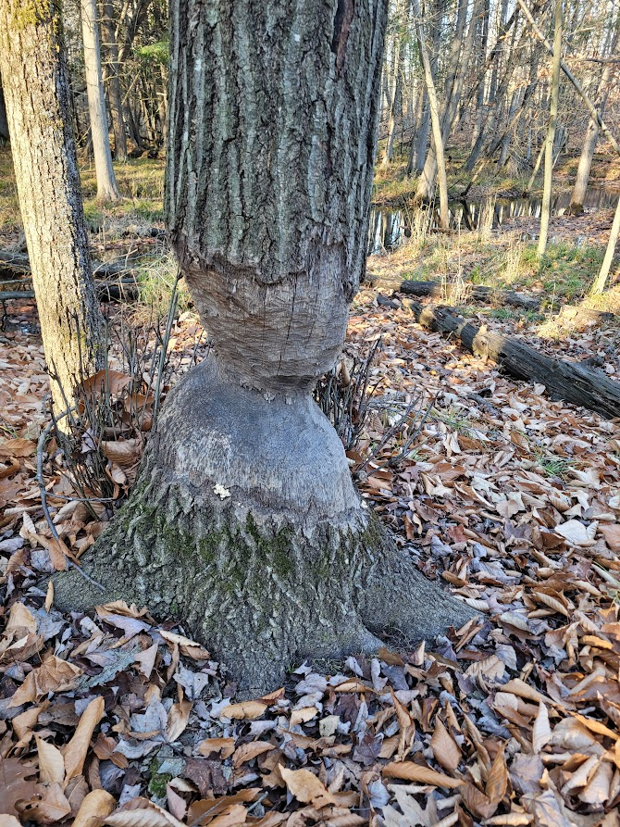
Bark
Texture
Lenticels – pores for gas exchange
Peeling strips
Smooth
Ridges & furrows
Scales & plates
Vertical or horizontal strips
Vertical cracks or seams
Color
Black
Red or maroon
White or grey
Blue or green
Source: Wojtech 2011. Bark a field guide to trees of the northeast. Brandeis University Press
Signs of damage
Beech bark disease, Ash borer, bark beetles
Frost cracks, lightning
Wildlife (beavers, deer rubs, porcupine, pileated woodpecker)

Slide 9
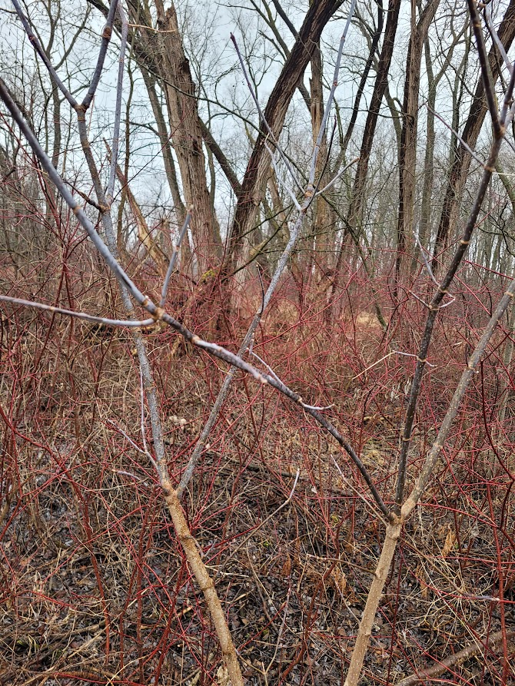
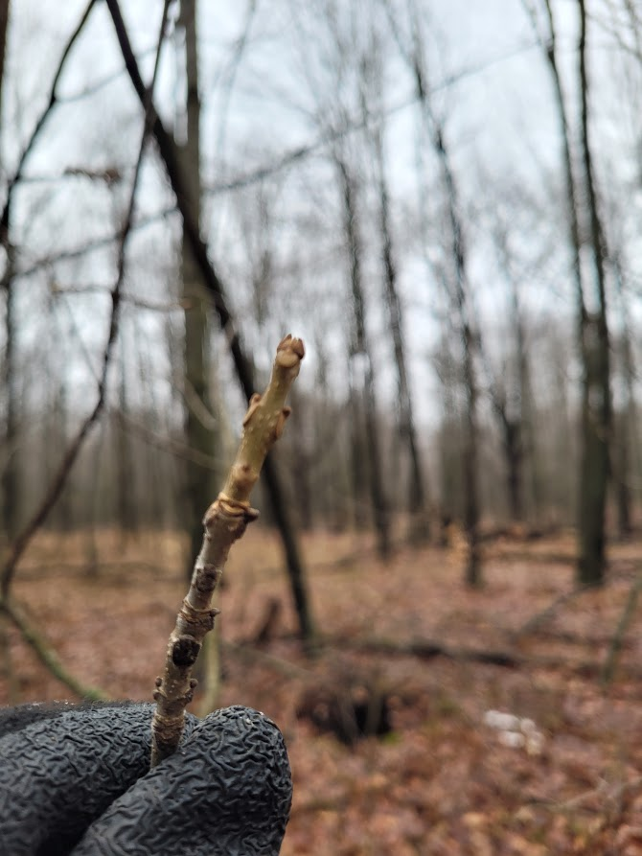
Twigs & Buds
Color
Red or maroon
Black or grey
Brown or yellow
Texture
Smooth
Rough
Sticky
Shape/Form
Pointed, blunt buds
Hanging
Upright
Dense
Sparse

Slide 10
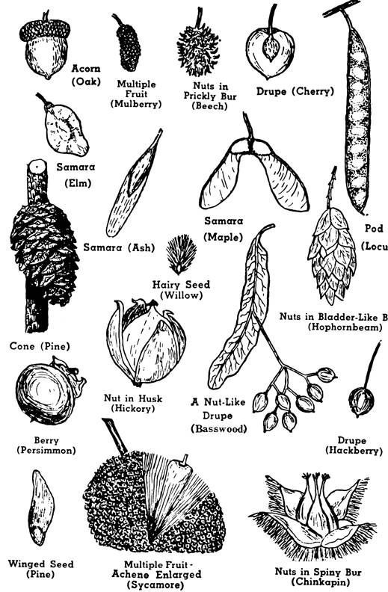
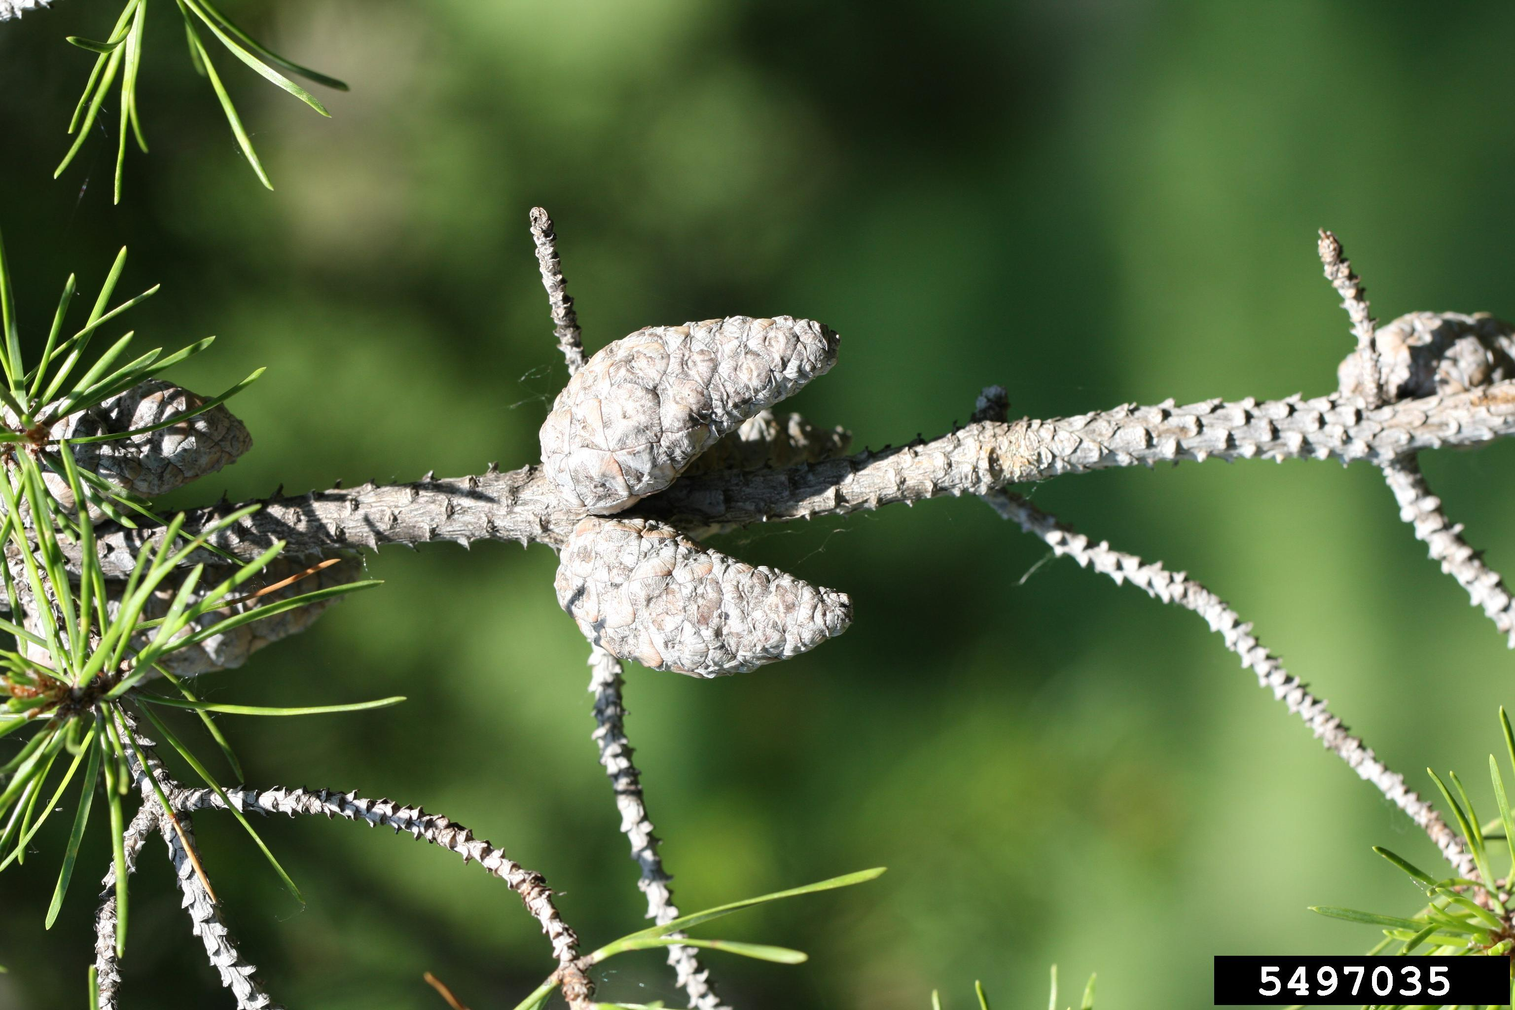
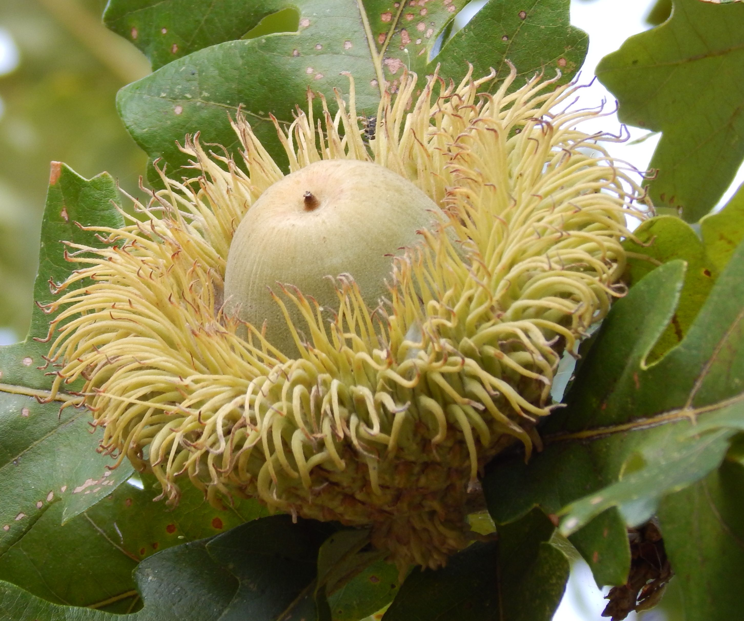
Seeds
Type
Samara
Drupe, berry, multiple fruit
Cone
Nut or acorn
Form
Curved pinecone of jack pine
Double samara of maple, angle differs by species
Burs on bur oak acorn
Size & Color
Steven Katovich, Bugwood.org
Robert Vidéki, Doronicum Kft., Bugwood.org
Paul Wray, Iowa State University, Bugwood.org
https://i.pinimg.com/originals/ba/12/71/ba1271dbfa30a9823a5a461f17711f2d.jpg
forestry.about.com

Slide 11
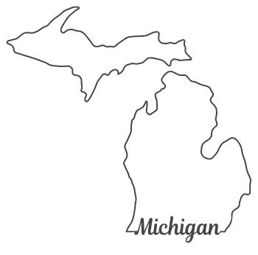
(Some) Common trees in Clare County, MI

Slide 12
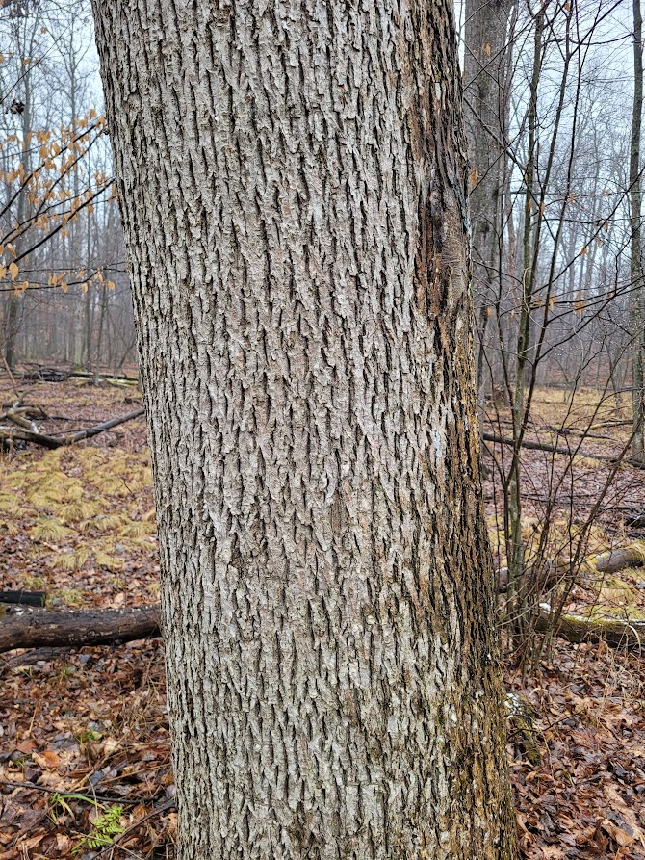
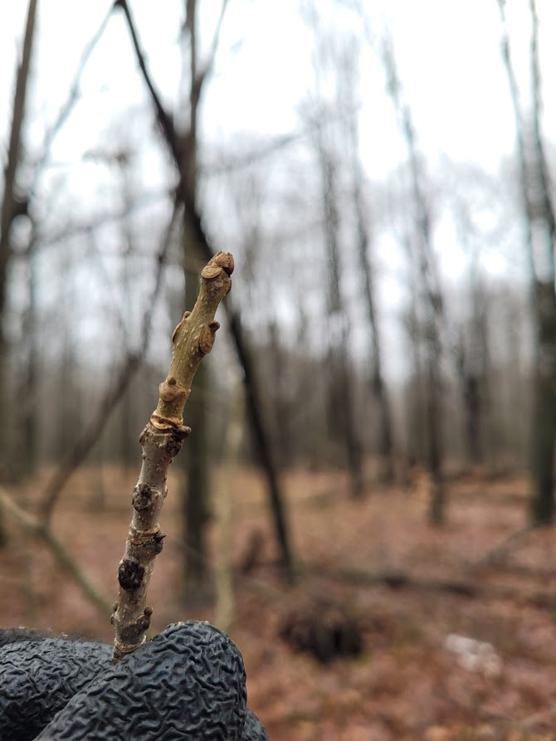
Ash - Fraxinus
**Live, mature ash are now uncommon due to the emerald ash borer and our native ash species at critically endangered.
White ash (Fraxinus americana)
Black ash (Fraxinus nigra)
Green ash (Fraxinus pennsylvanica)

Slide 13
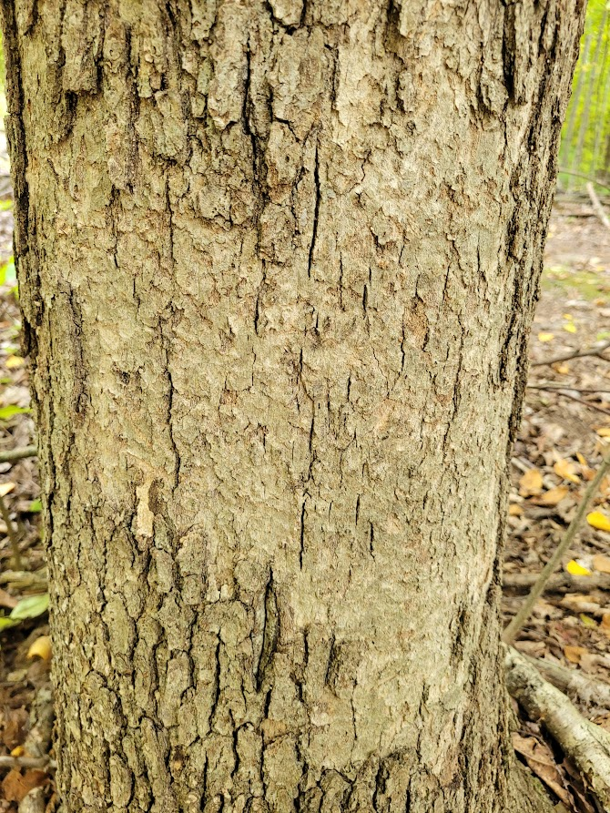
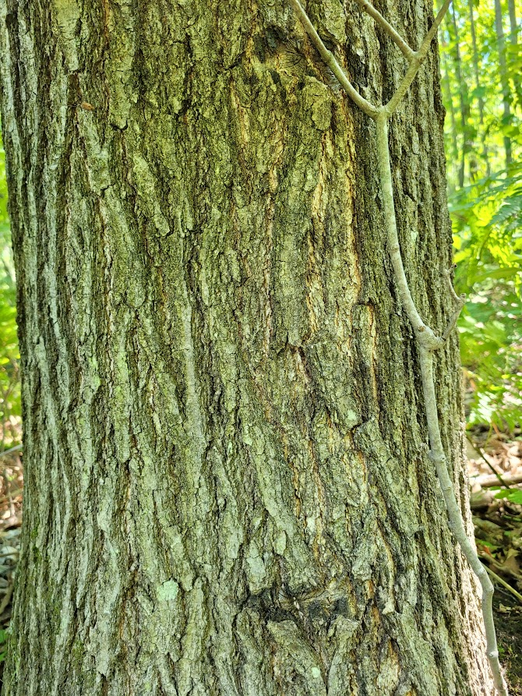
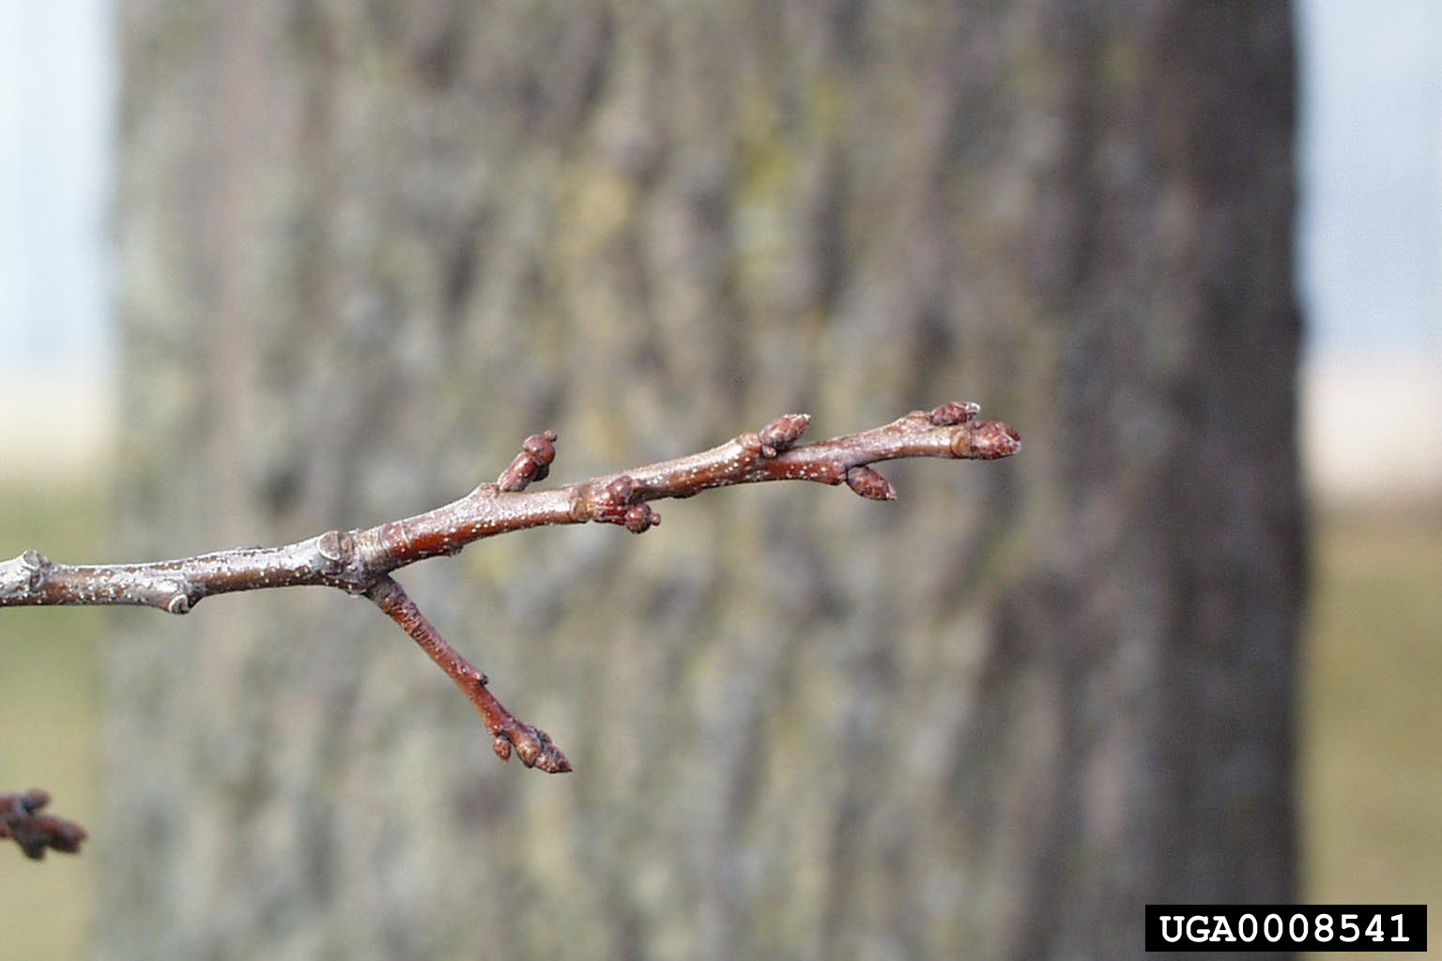
Oak - Querca
Smooth patch disease on White oak
White oak group
White oak (Quercus alba)
Swamp white oak (Quercus bicolor)
Bur oak (Quercus macrocarpa)
Red oak group
Northern red oak (Quercus rubra)
Black oak (Quercus velutina)
Scarlet oak (Quercus coccinea)
Northern pin oak (Quercus ellipsoidalis)
Pin oak (Quercus palustris)
Northern red oak
Paul Wray, Iowa State University, Bugwood.org

Slide 14
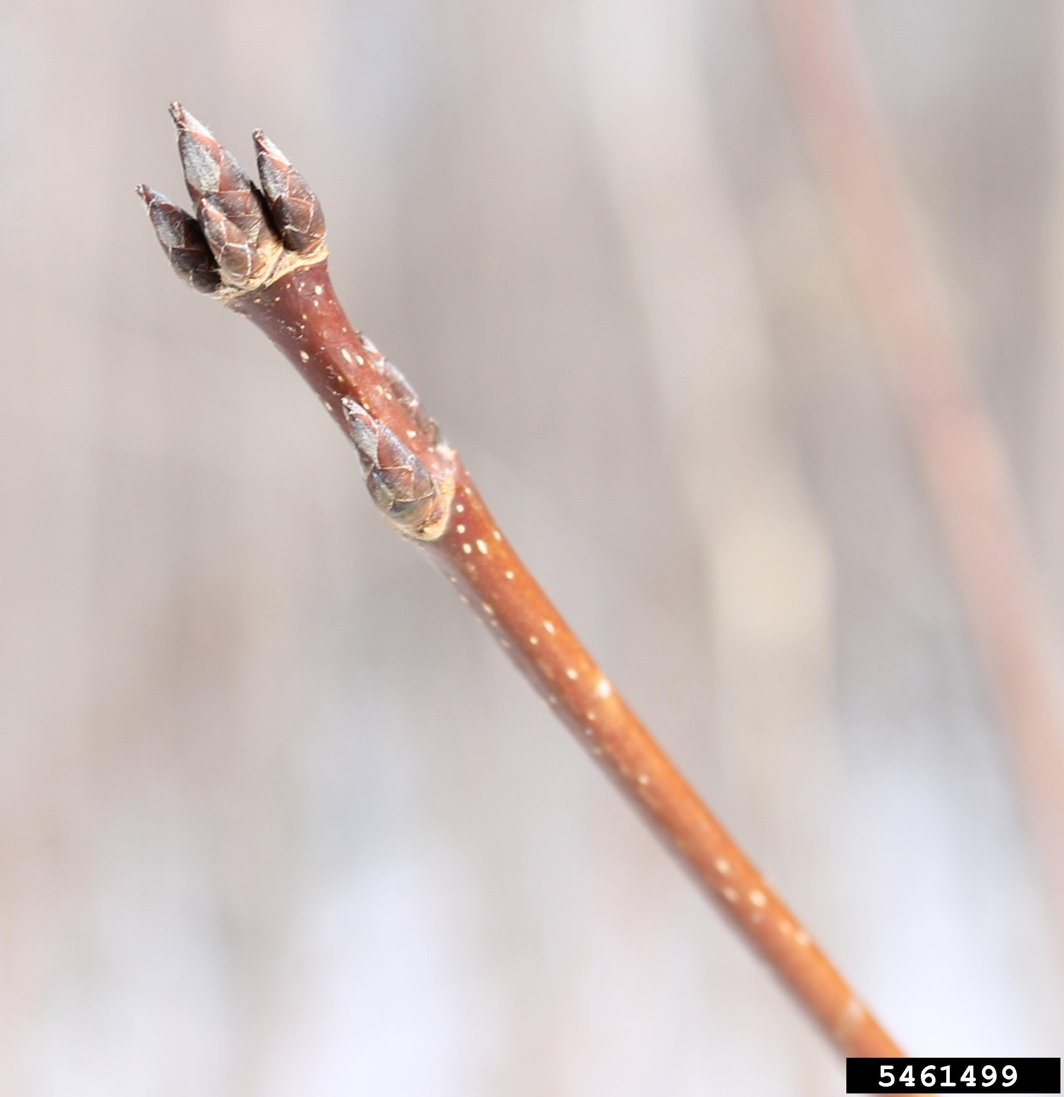
Maple - Acer
Soft maple group
Red maple (Acer rubrum)
Silver maple (Acer saccharinum)
Boxelder (Acer negundo)
Mountain maple (Acer spicatum)
Hard maple group
Sugar maple (Acer saccharum)
Black maple (Acer nigrum)
Norway maple (Acer platanoides)
Rob Routledge, Sault College, Bugwood.org
Source: Wojtech 2011. Bark a field guide to trees of the northeast. Brandeis University Press

Slide 15
Aspen (Poplar) - Populus
Bigtooth aspen (Populus grandidentata)
Quaking aspen (Populus tremuloides)
Cottonwood (Populus deltoides)
Balsam poplar (Populus balsamifera)
Source: Wojtech 2011. Bark a field guide to trees of the northeast. Brandeis University Press

Slide 16
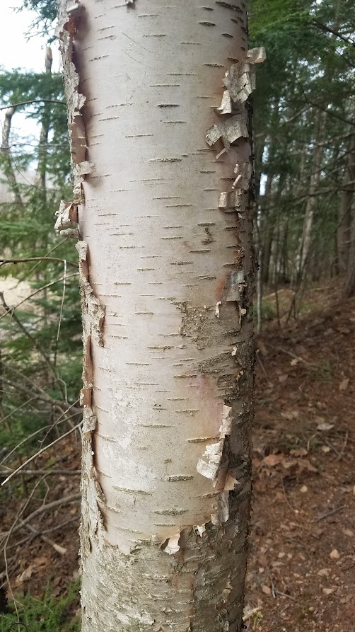
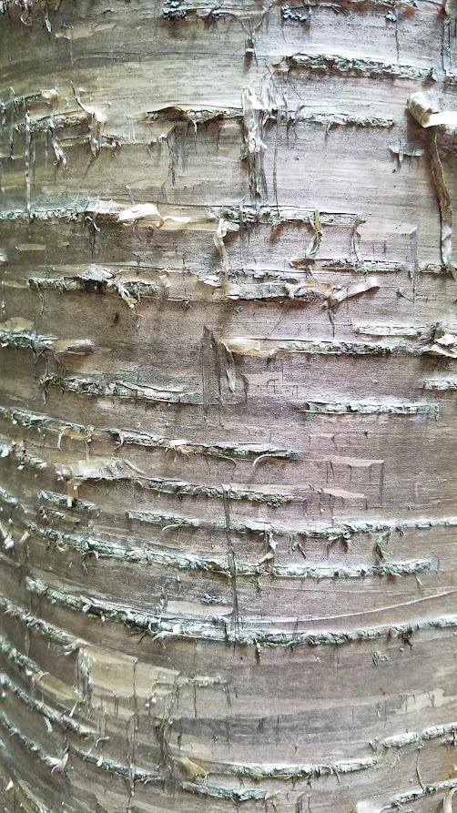
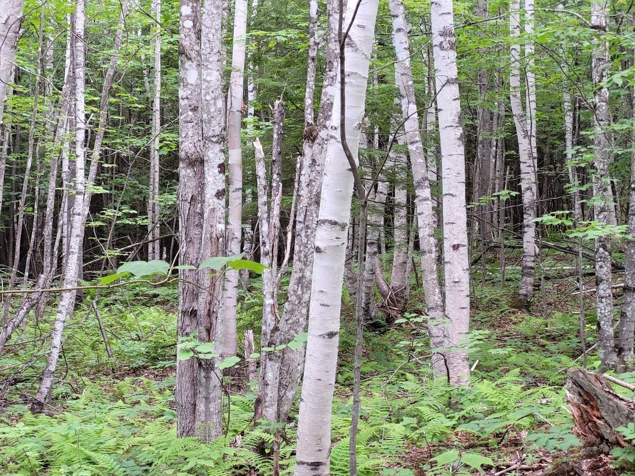
Birch - Betula
White birch (Betula papyrifera)
Yellow birch (Betula alleghaniensis)
River birch (Betula nigra)

Slide 17
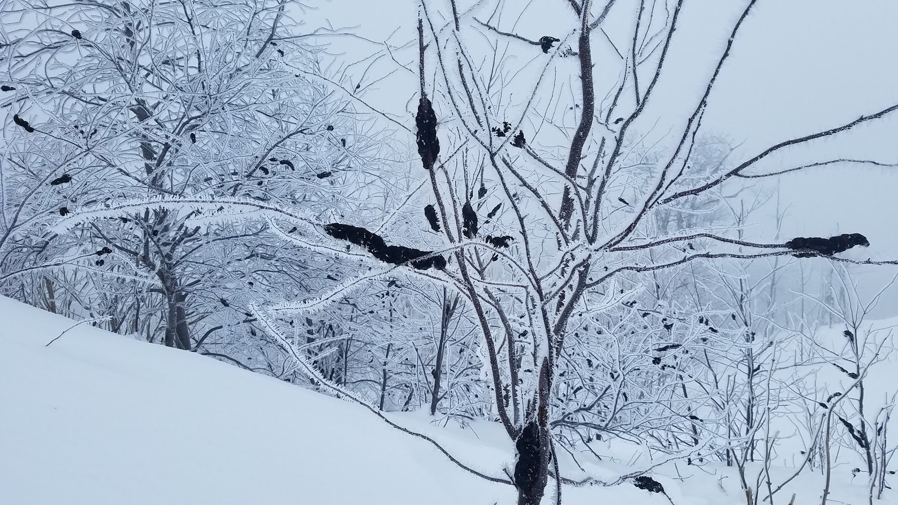
Cherry - Prunus
Pin cherry (Prunus pensylvanica)
Choke cherry (Prunus virginiana)
Black cherry (Prunus serotina)
Source: Wojtech 2011. Bark a field guide to trees of the northeast. Brandeis University Press

Slide 18
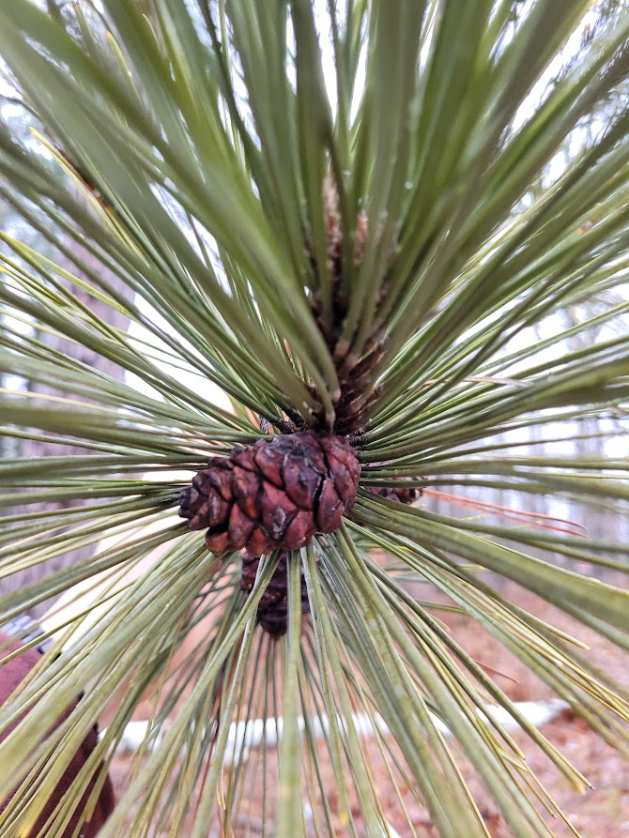
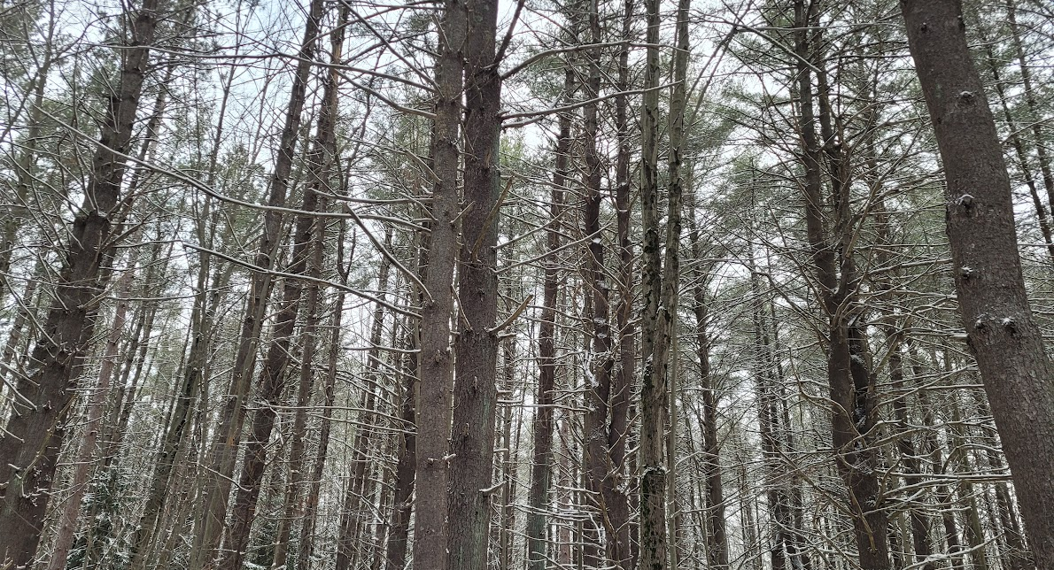
Pine - Pinus
White pine (Pinus strobus)
Red pine (Pinus resinosa)
Jack pine (Pinus banksiana)
Scotch pine* (Pinus sylvestris)
Austrian pine* (Pinus nigra)
*Non-native
Source: Wojtech 2011. Bark a field guide to trees of the northeast. Brandeis University Press

Slide 19
Spruce - Picea
White spruce (Picea glauca)
Black spruce (Picea mariana)
Norway spruce* (Picea abies)
Colorado blue spruce* (Picea pungens)
*Non-native
Source: Wojtech 2011. Bark a field guide to trees of the northeast. Brandeis University Press

Slide 20
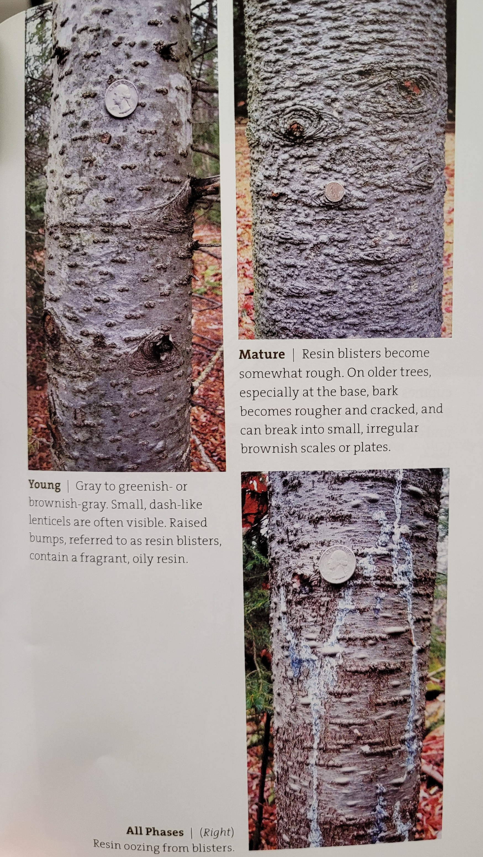
Fir - Abies
Balsam fir (Abies balsamea)
Frasier fir* (Abies fraseri)
Concolor fir* (Abies concolor)
Grand fir* (Abies grandis)
Douglas fir* (not a true fir) (Pseudotsuga menziesii)
*Non-native
Source: Wojtech 2011. Bark a field guide to trees of the northeast. Brandeis University Press

Slide 21
Hemlock - Tsuga
Eastern hemlock (Tsuga canadensis)
Source: Wojtech 2011. Bark a field guide to trees of the northeast. Brandeis University Press

Slide 22
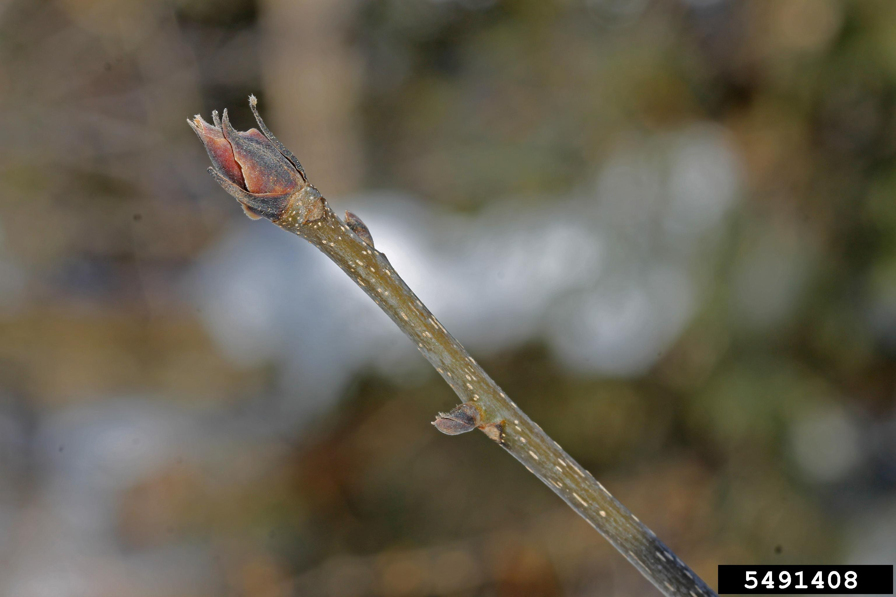
Hickory - Carya
Shagbark
Shagbark hickory (Carya ovata)
Bitternut hickory (Carya cordiformis)
Pignut hickory (Carya glabra)
Bitternut
Source: Wojtech 2011. Bark a field guide to trees of the northeast. Brandeis University Press
Rob Routledge, Sault College, Bugwood.org

Slide 23
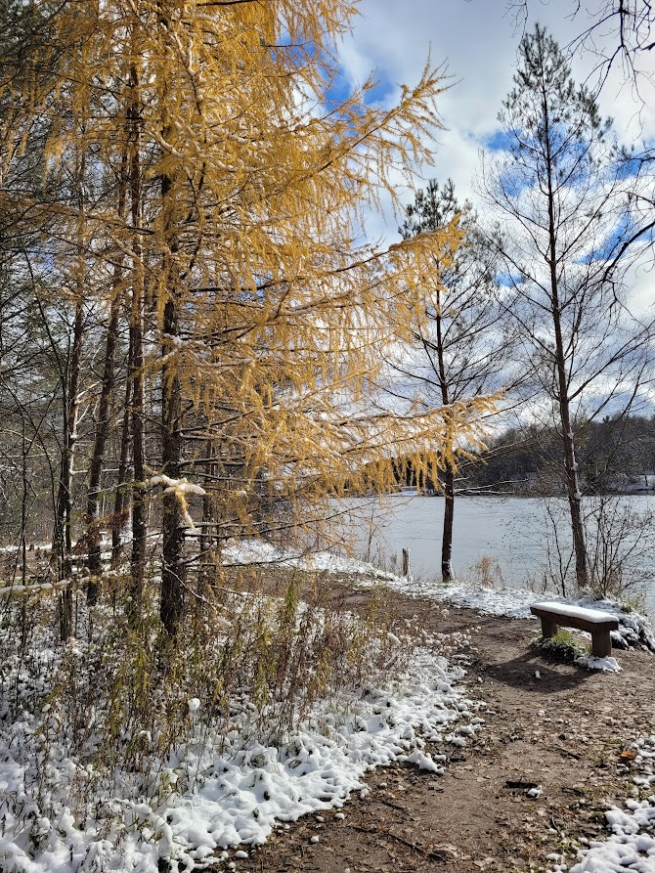
Tamarack - Larix
Eastern larch (tamarack) (Larix laricina)
European larch* (Larix decidua)
*Non-native
Source: Wojtech 2011. Bark a field guide to trees of the northeast. Brandeis University Press

Slide 24
Cedar - Thuja
Northern white cedar (Thuja occidentalis)
Eastern red cedar (not a true cedar) (Juniperus virginiana)
Source: Wojtech 2011. Bark a field guide to trees of the northeast. Brandeis University Press

Slide 25
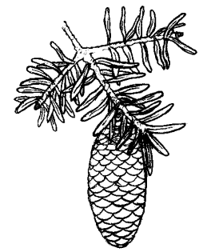
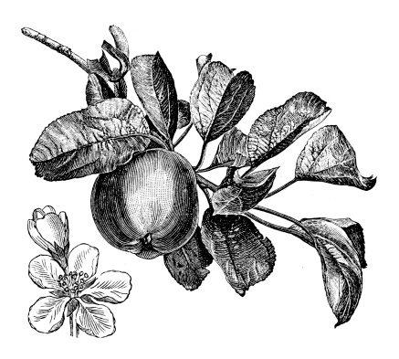
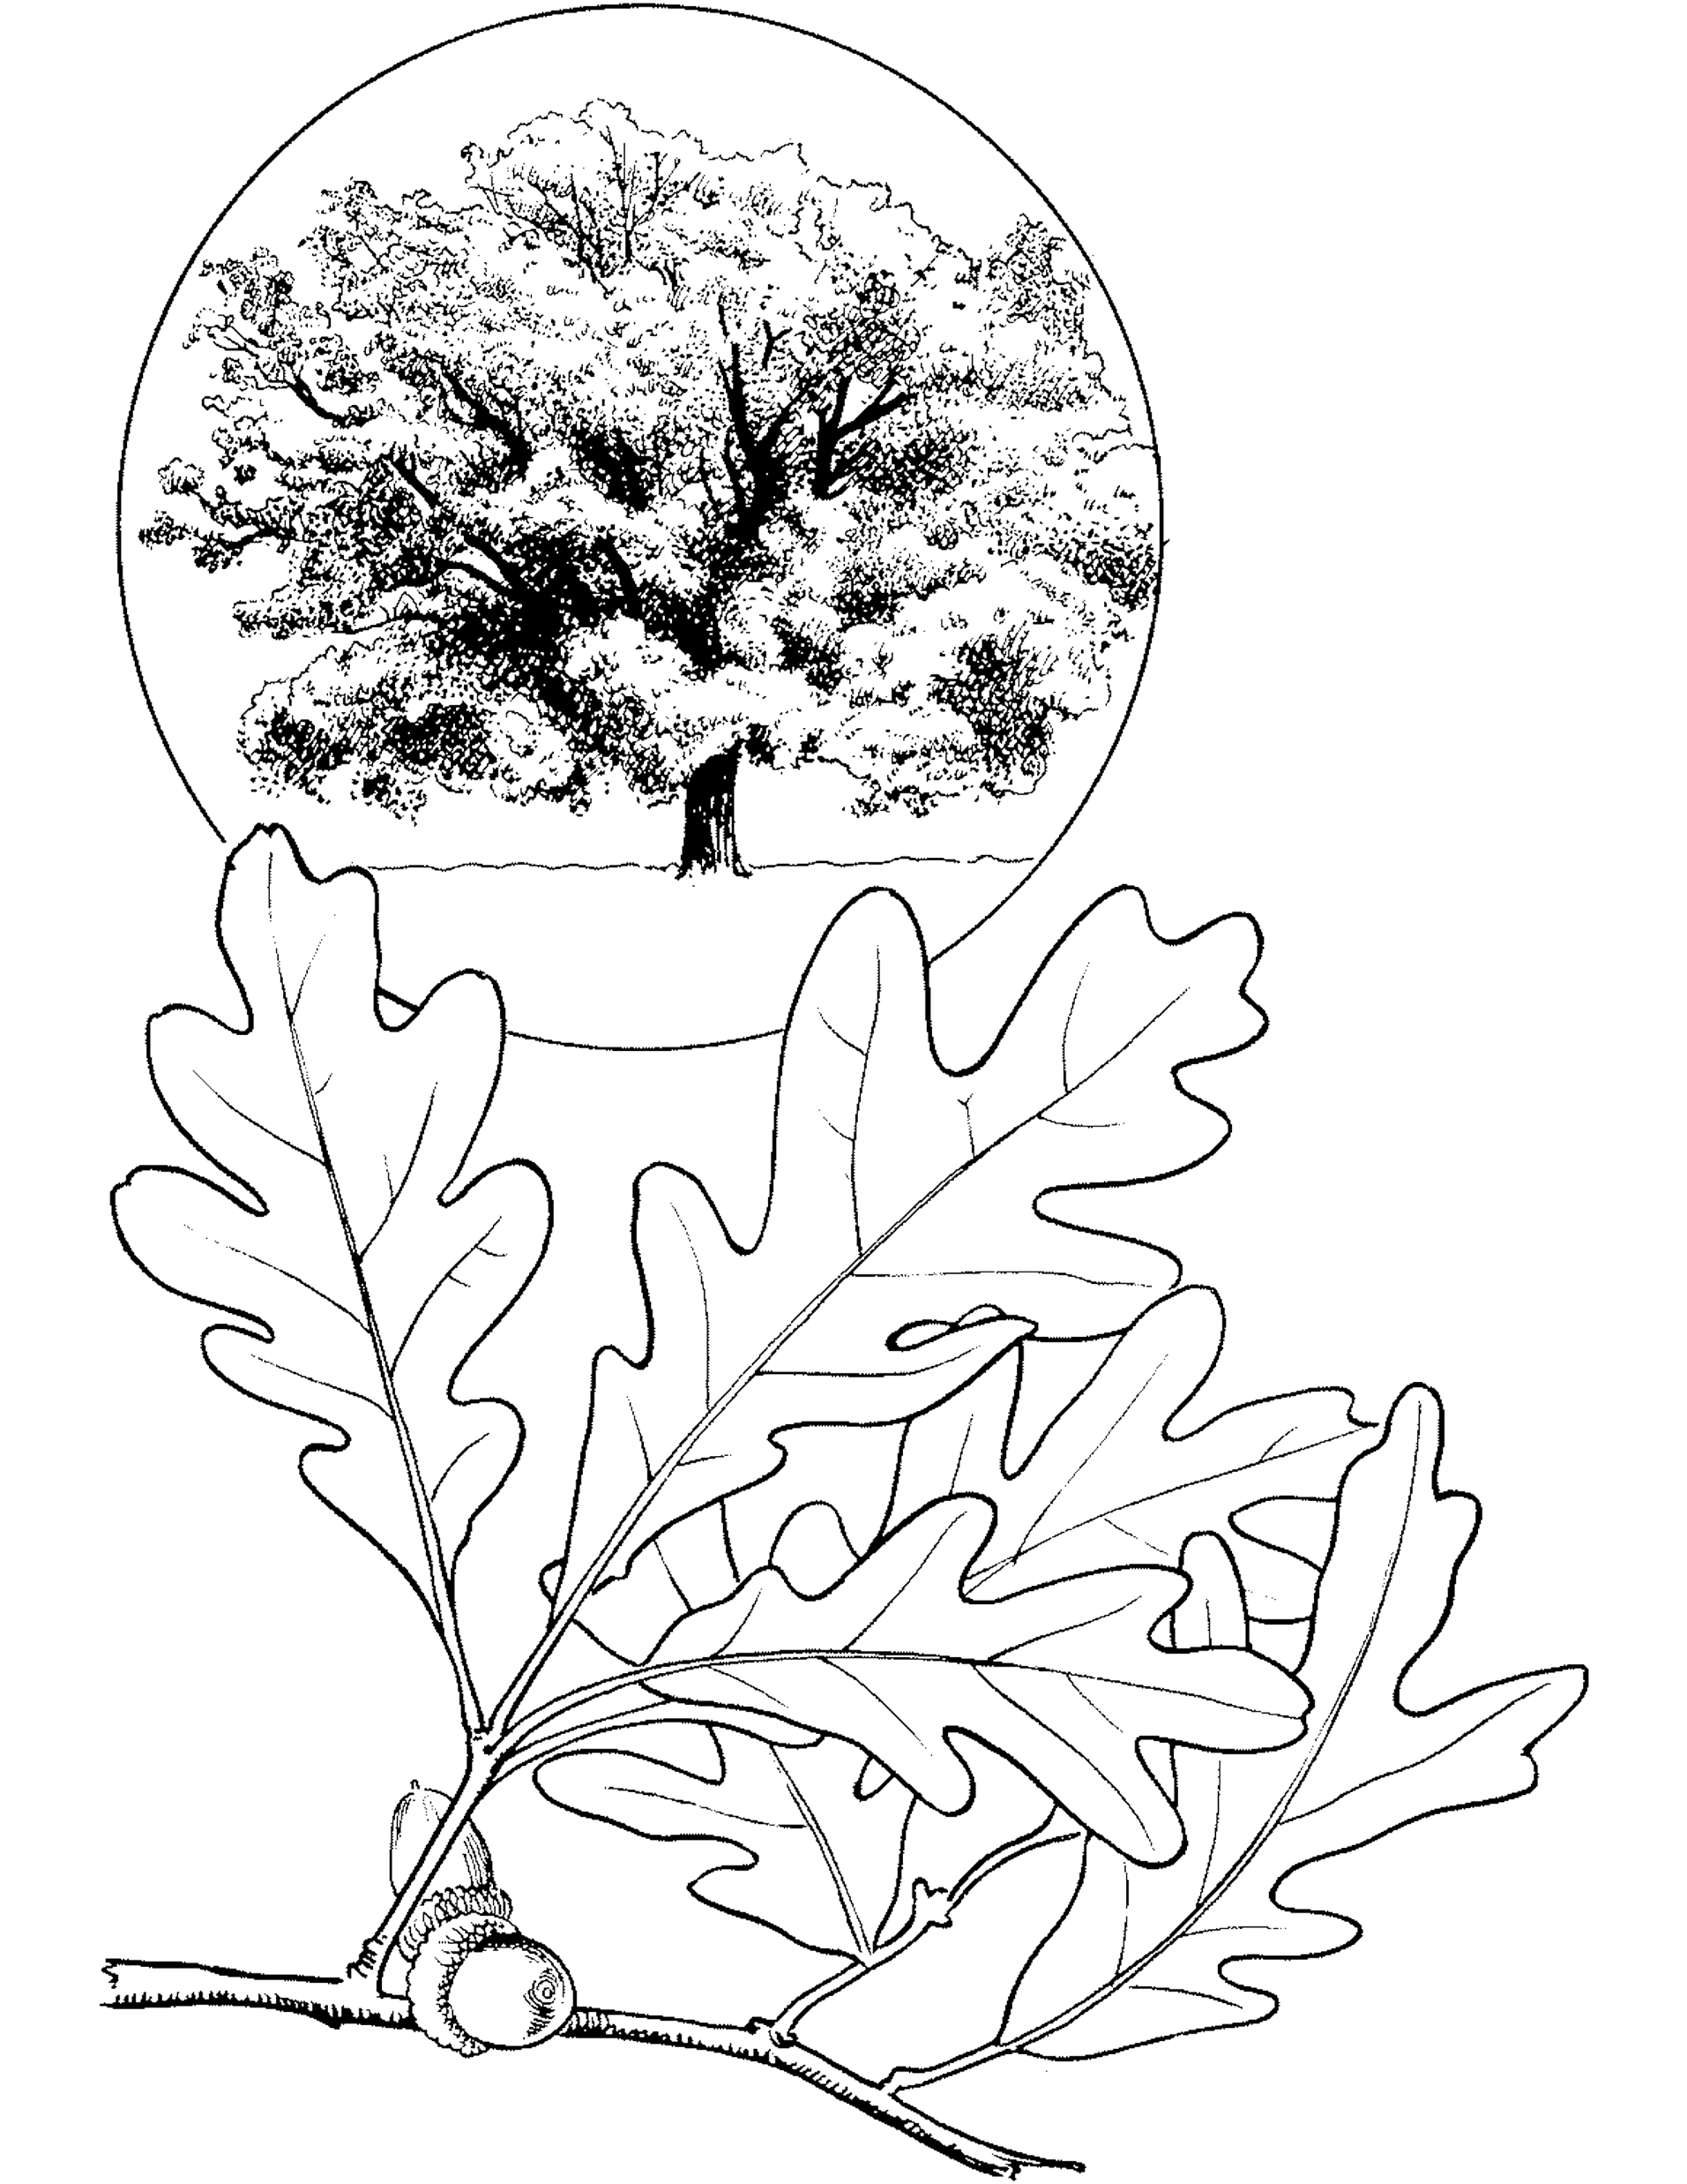
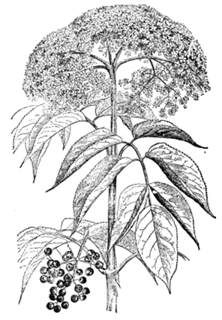
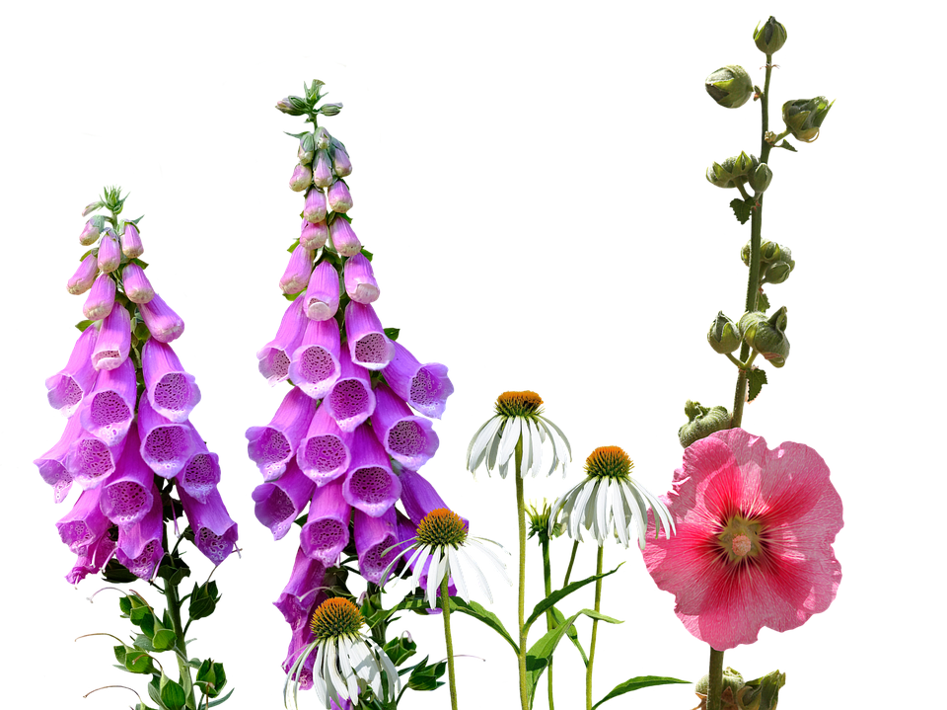
Stay tuned for our spring tree sale!
Conifers
Hardwoods
Fruit trees
Shrubs
Wildflowers
Order forms will be posted on our website clarecd.org
and on Facebook the week of 2/6.
We will also mail hard copies if you are on our mailing list!
Not on our mailing list?
Let me know your contact info and we will add you!

Slide 26
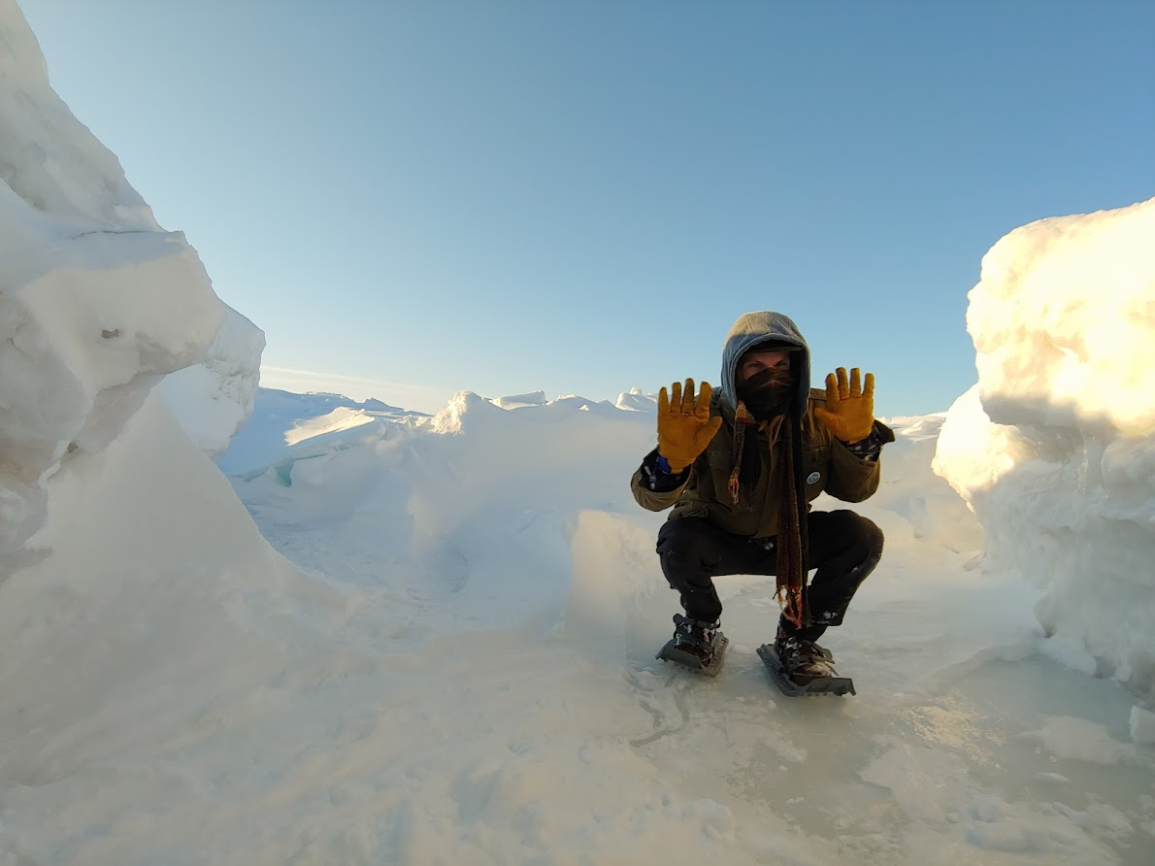
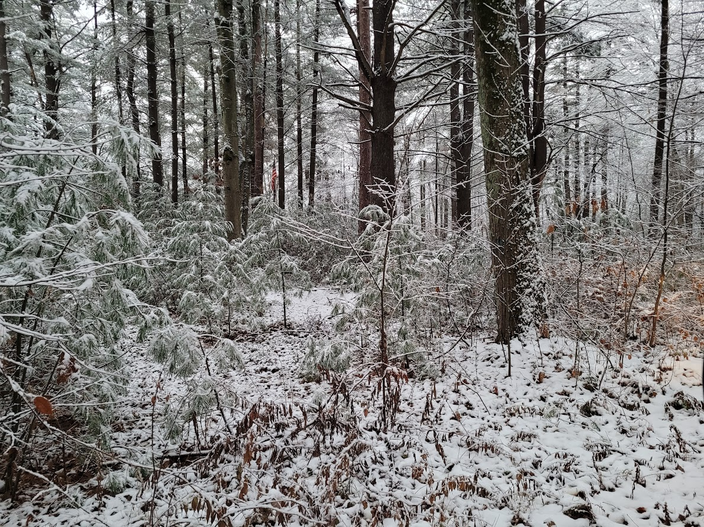
Thank you, and enjoy the woods!
Joe Nash – Forester
Clare and Gladwin Conservation Districts
(989) 539-6401 Ext. 3
joe.nash@macd.org

